Slide 1
Structures in C++

Slide 2
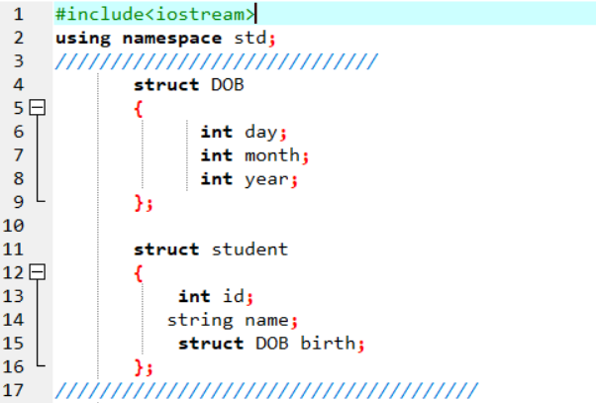
Nested Structure

Slide 3
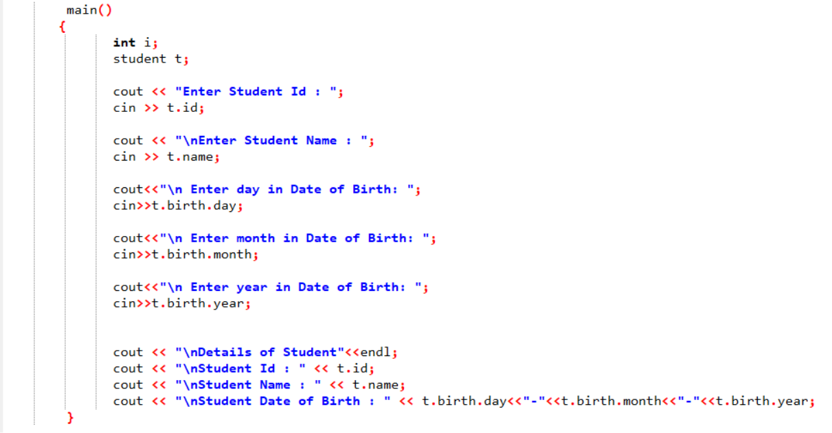

Slide 4
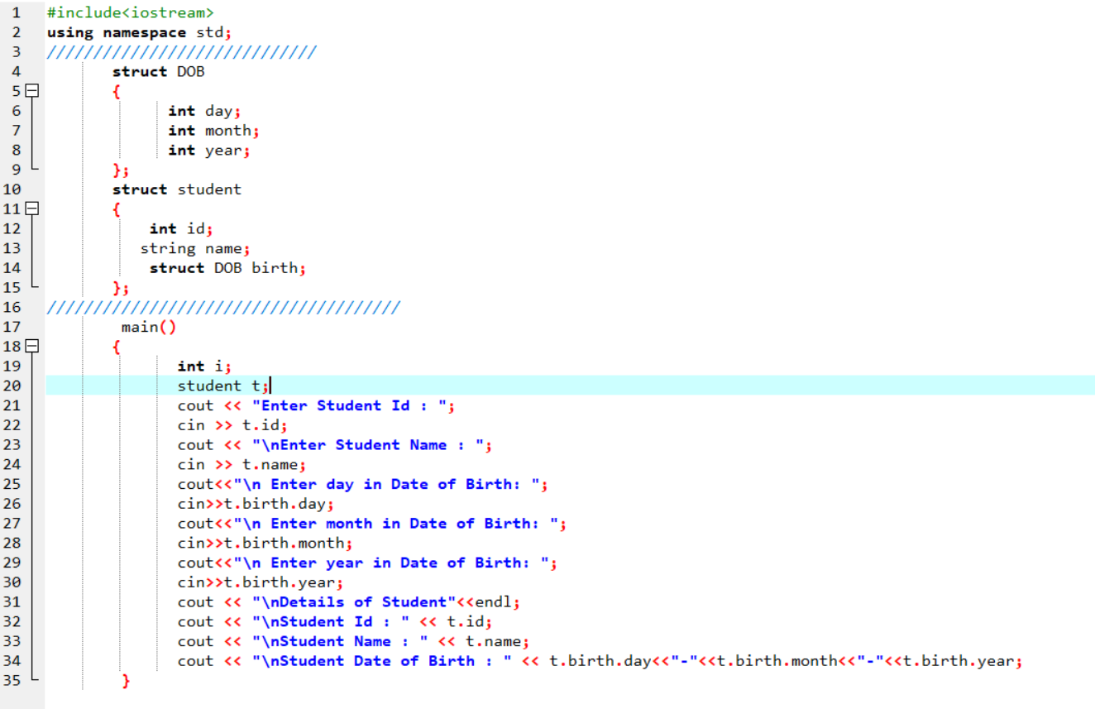

Slide 5
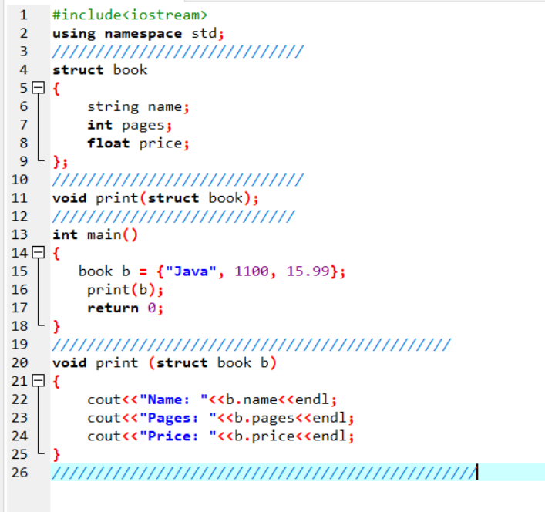
Passing Structure
as Argument
To the FUNCTION

Slide 6
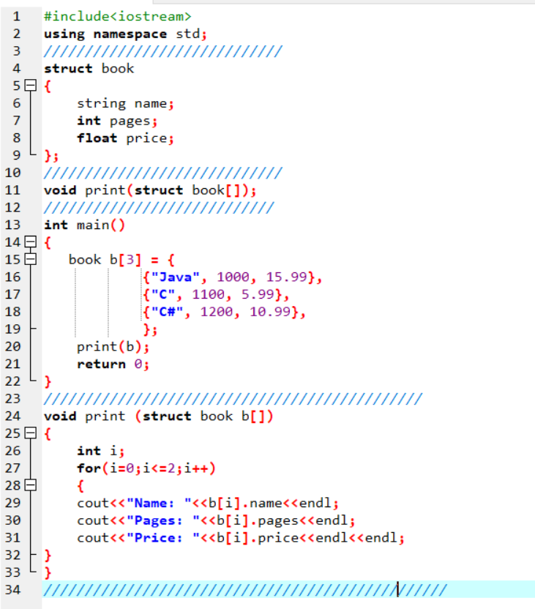
Array of Structures as Function Arguments

Slide 7
File
ofstream: Stream class to write on files
ifstream: Stream class to read from files
fstream: Stream class to both read and write from/to files.

Slide 8
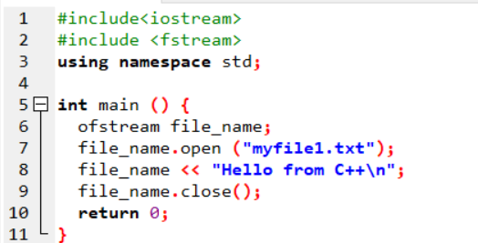

Slide 9
